Slide 1


Is it Fantasy
or
Reality?
You decide...

Slide 2

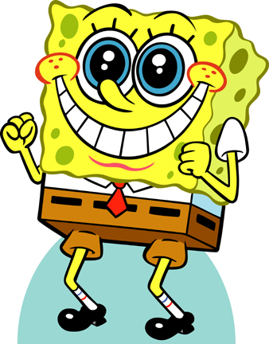
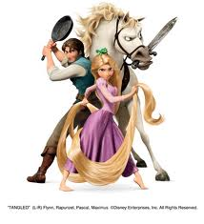
Fantasy:
Is a picture or dream created by the imagination

Slide 3
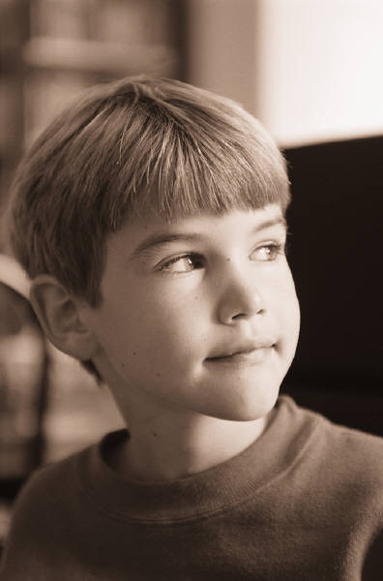
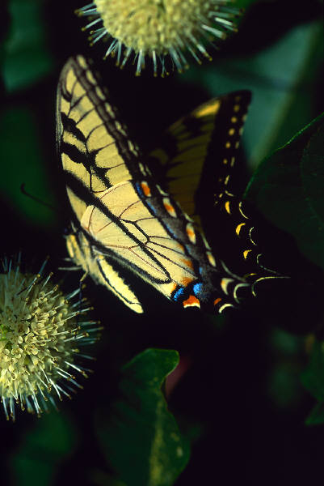
Reality:
Is everything that lives or happens in real life

Slide 4
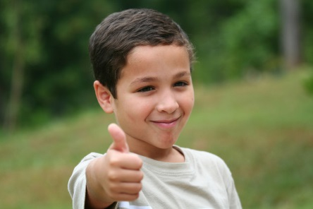
You Decide!
Thumbs up if you think the sentence is a reality.
Thumbs down if you think the sentence is a fantasy.

Slide 5

Mice have a BBQ

Slide 6
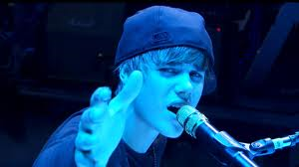
Justin Beiber Sings

Slide 7
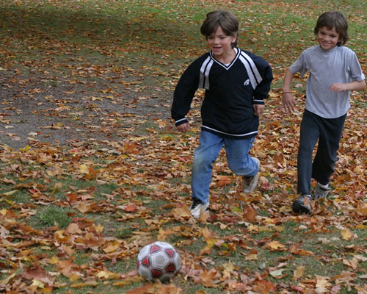
Kids like to play

Slide 8
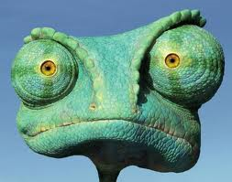
Rango lives in your town!

Slide 9
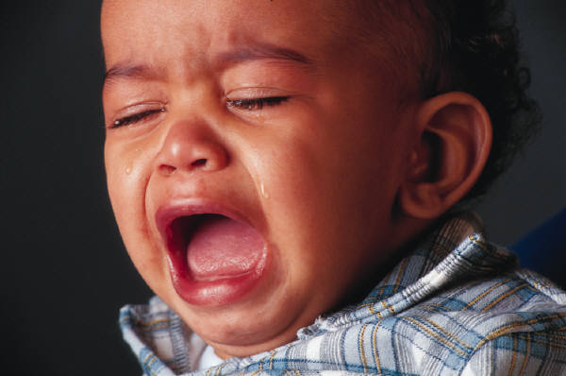
Babies Cry

Slide 10
Dragons make good pets

Slide 11
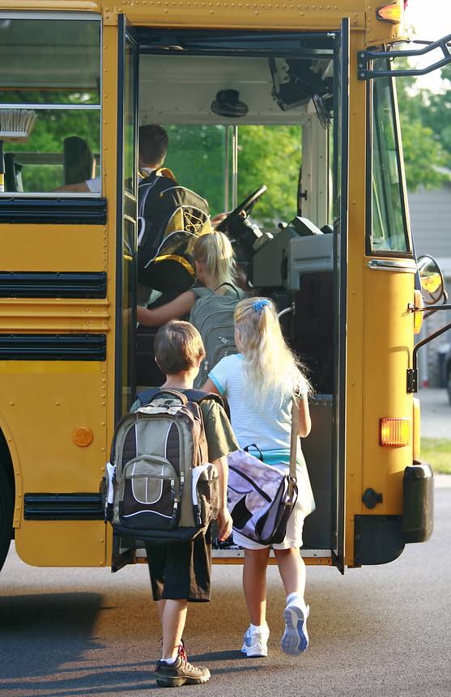
A School bus can take
you to school

Slide 12
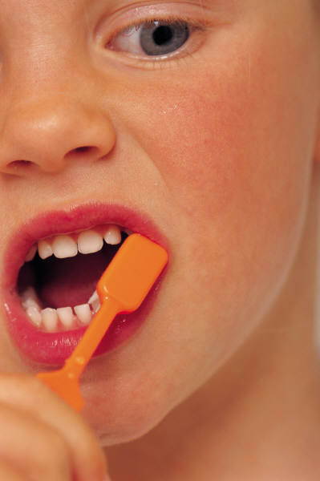
We all brush our teeth

Slide 13
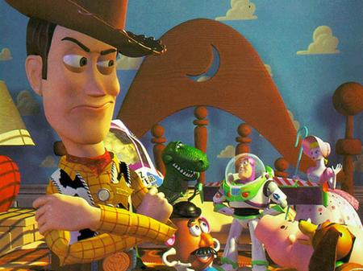
Andy’s toys like to go on adventures

